Slide 1
VISA APPROVAL PREDICTION
Using Machine Learning
Smartinternz Externship
Developed by:
MANDA ANIL
MAJJIGA KARTHIK
CHIPPA SHIVATEJA
KAITHA SAMBARAJU

Slide 2
TABLE OF CONTENTS
Introduction
Purpose
Block Diagram
Process Flow
Flow Chart
Software Designing
Experimental Investigation
Advantages and Disadvantages
Conclusion

Slide 3
INTRODUCTION
This project deals with the task of predicting the outcome of immigration visa applications by using machine learning methods. The prediction task is treated as one of supervised inductive learning of classification functions. Exploratory data analysis was also performed to analyze the main characteristics of the data set. A prediction model was developed which trains on historical data of the same application domain and uses machine learning classifiers to predict the outcome of visa petitions.
Each fiscal year the United States government grants a total of 85,000 new H-1B visas; this includes 65,000 visas for overseas workers with at least a bachelor’s degree and 20,000 visas available for those employees with an advanced degree in a specialty field from an accredited United States academic institution. The allotment of these visas is said to be a lottery system not depending on any specific criteria. Thus, a foreign national is not guaranteed selection for an H1B visa merely because he or she fulfills all the qualifying criteria. This work aims to use machine 2 learning on known factors to make predictions under this uncertainty, with accuracy better than that achieved using the prior probability.

Slide 4
PURPOSE
Our aim from the project is to make use of pandas, matplotlib , & seaborn libraries from python to extract the libraries for machine learning for the Visa prediction.
Secondly, to learn how to hyper tune the parameters using grid search cross validation for the Naïve Bayes machine learning algorithm.
And in the end, to predict whether the Visa applicant can replay the Visa or not using voting ensemble techniques of combining the predictions from multiple machine learning algorithms and withdrawing the conclusions.

Slide 5
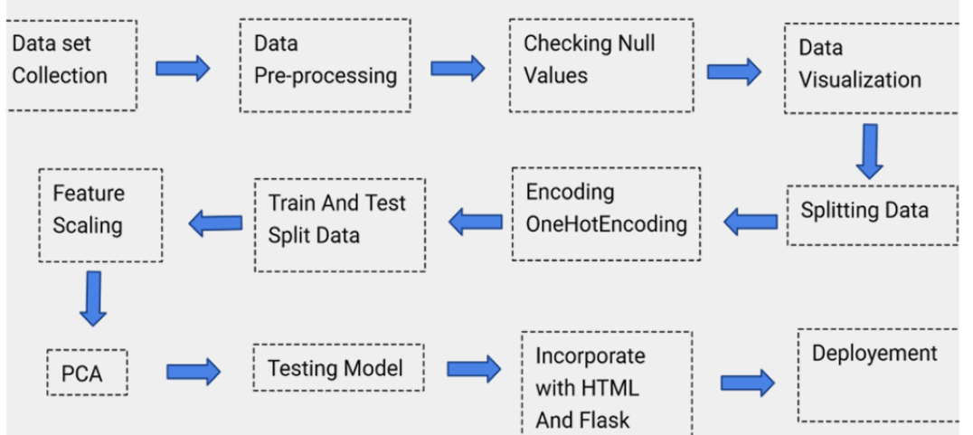
BLOCK DIAGRAM

Slide 6
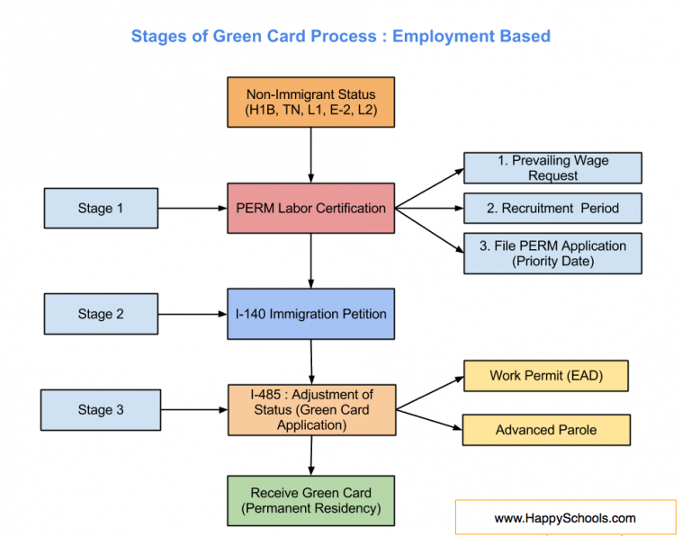
PROCESS FLOW

Slide 7
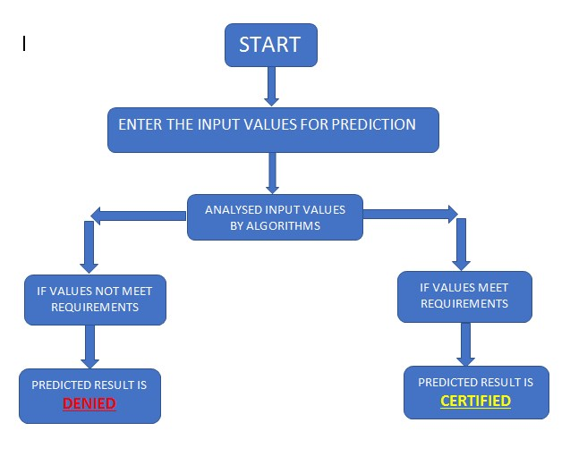
FLOW CHART

Slide 8
SOFTWARE DESIGNING
Jupyter Notebook Environment.
Machine Learning Algorithms.
Python Web Frame Works , Python For Data Analysis
We developed this forest fire prediction by using the Python language which is a interpreted and high level programming language and using the Machine Learning algorithms. for coding we used the Jupyter Notebook environment of the Anaconda distributions, it is an integrated scientific programming in the python language.

Slide 9

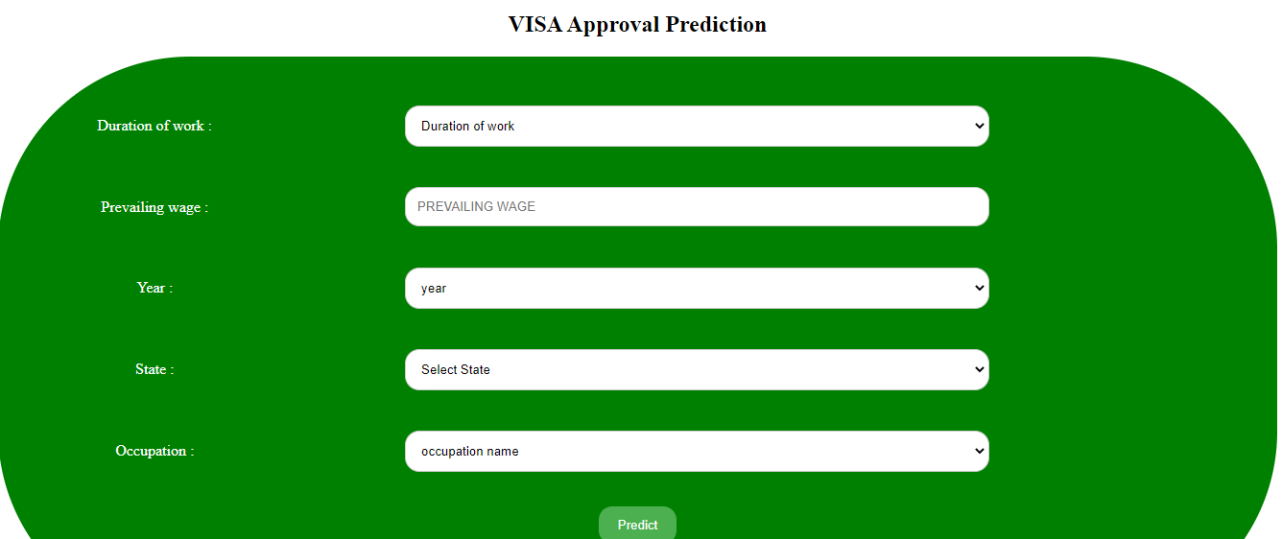
EXPERIMENTAL INVESTIGATION
EXPERIMENTAL INVESTIGATION
In this paper, the dataset we used is derived from H-1B_Kaggle .It contains more than 9L H-1B Visa data of users .It contained 7 features and 1 label which can be examined attributesNext step is to build model. After that video streaming will detects the images. Those collection of forest outputs are given below
(i) Predicted as Visa Approval Status Analysis
  (ii) Program form Visa Approval Prediction

Slide 10

Continue..
(i)Predict when Visa Certified
(ii) Predict when Visa Denied

Slide 11
ADVANTAGES
Naive Bayes give the accurate result of the prediction upto 98% which is the algorithm we used for prediction.
H-1B visa benefit ,and perhaps the main reason for its popularity, is the board requirements associated with qualifying for the visa
Duration of Stay
Dual Intent (pursue legal permanent residency) while under H-1B non-immigrant status.
DISADVANTAGES
Lottery.
Extensions.
Due to lottery process,there are strict dates the must be adhgered to during process.

Slide 12
CONCLUSION
Inorder to predict the outcome of H-1B visa applications based on the attributes of the applicant ,several machine learning models like SVM, Naive Bayes can be used. Finally,this can be integrated to a web appliction.
The results show that the proposed algorithm achieves good detection rates. These results indicate that the proposed method is accurate and can be used in Visa Approval.

Slide 13
THANK YOU !

